Slide 1

Airbnb Amsterdam Analysis
By/ Nada Said Taha Beshir
Supervised by: Eng/ Donia Ghars El-Din
Powered by:
Ministry of Communications and Information Technology (NTI)
Data Analysis For Freelancing Program

Slide 2
Problem Statement:
How can Airbnb improve guest experience and revenue by analyzing neighborhood activity, pricing trends, and amenities?
Objective:
Identify the most active neighborhoods and pricing behavior
Analyze how property amenities affect pricing and customer engagement

Slide 3
Dataset & Tools
Dataset: Airbnb Amsterdam from Kaggle
6,173 rows of listings Features: price, location, amenities, reviews, availability, etc.
Tools Used:
Python → for cleaning preprocessing
SQL → for data exploration
Power BI → for dashboards

Slide 4
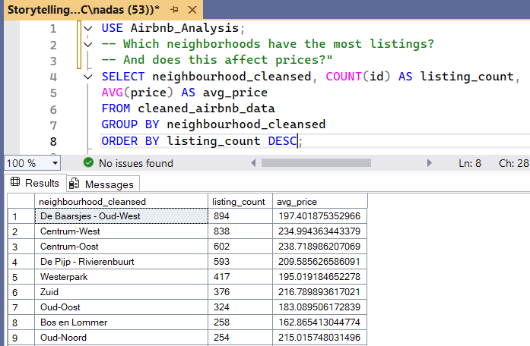
SQL for Business Questions

Slide 5
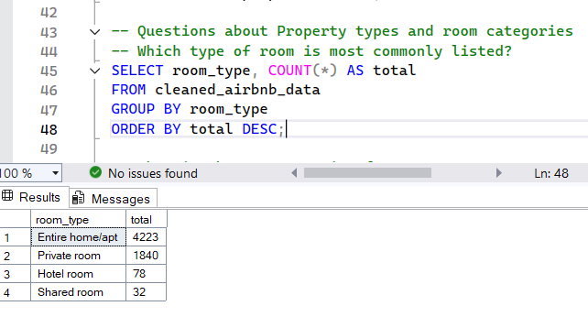
SQL for Business Questions

Slide 6
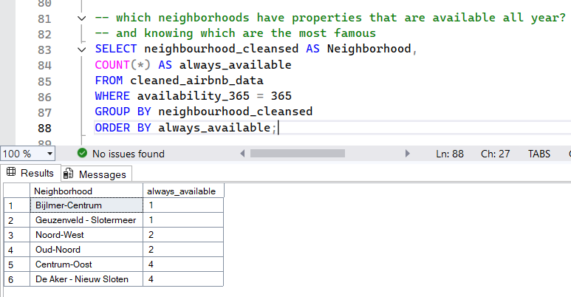
SQL for Business Questions

Slide 7
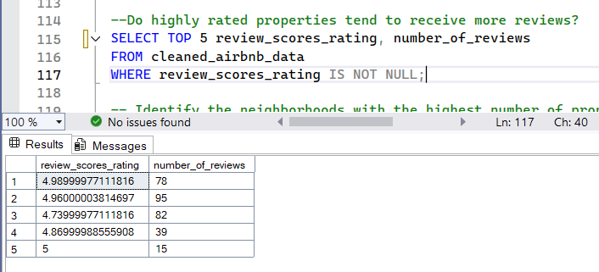
SQL for Business Questions

Slide 8
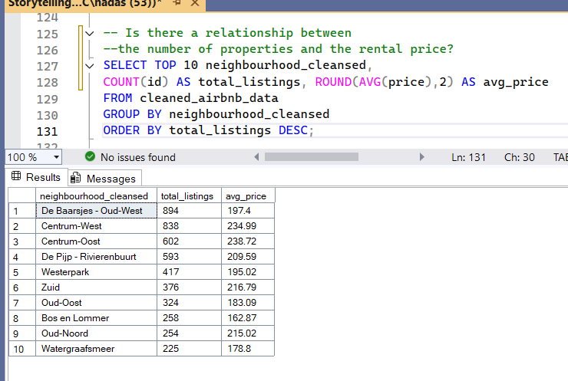
SQL for Business Questions

Slide 9
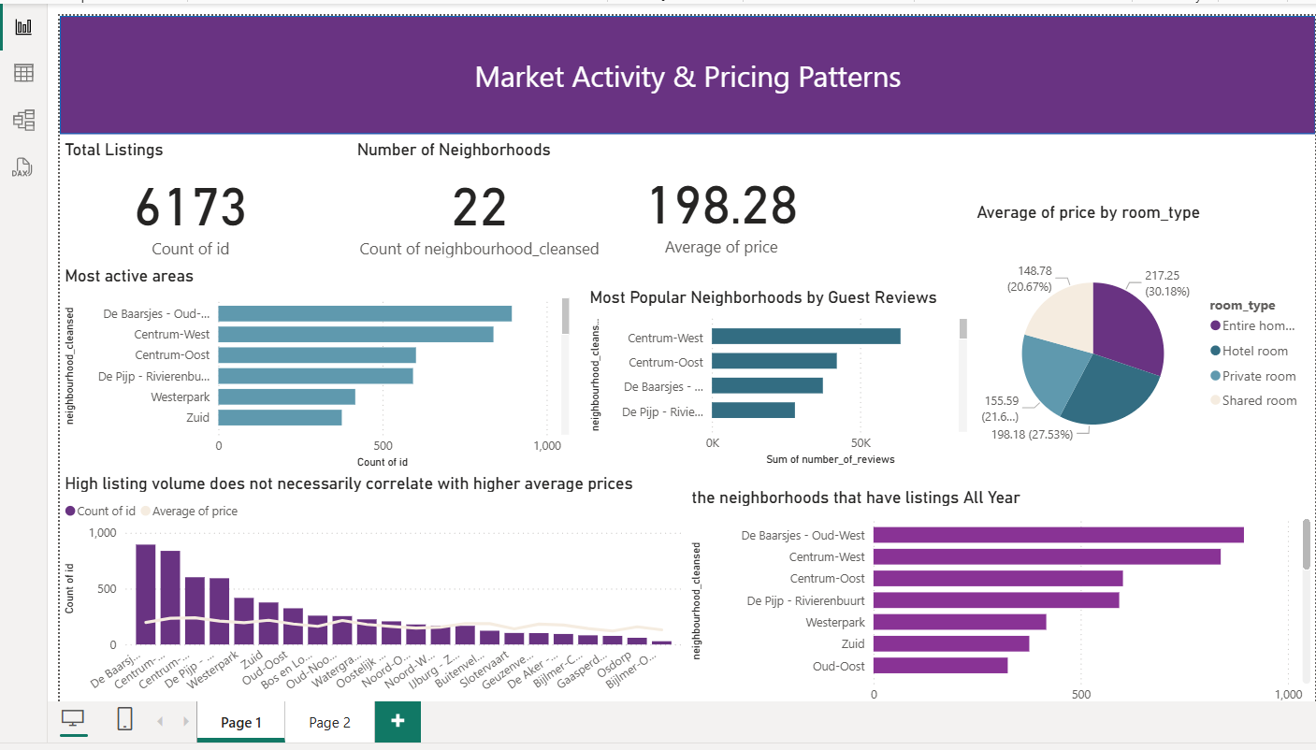
Dashboard Page 1 – Market Activity
Insights: Some neighborhoods have a high number of listings, but lower average prices, Popular areas (like Centrum-West) are not always the most expensive No direct correlation between number of listings and high prices.

Slide 10
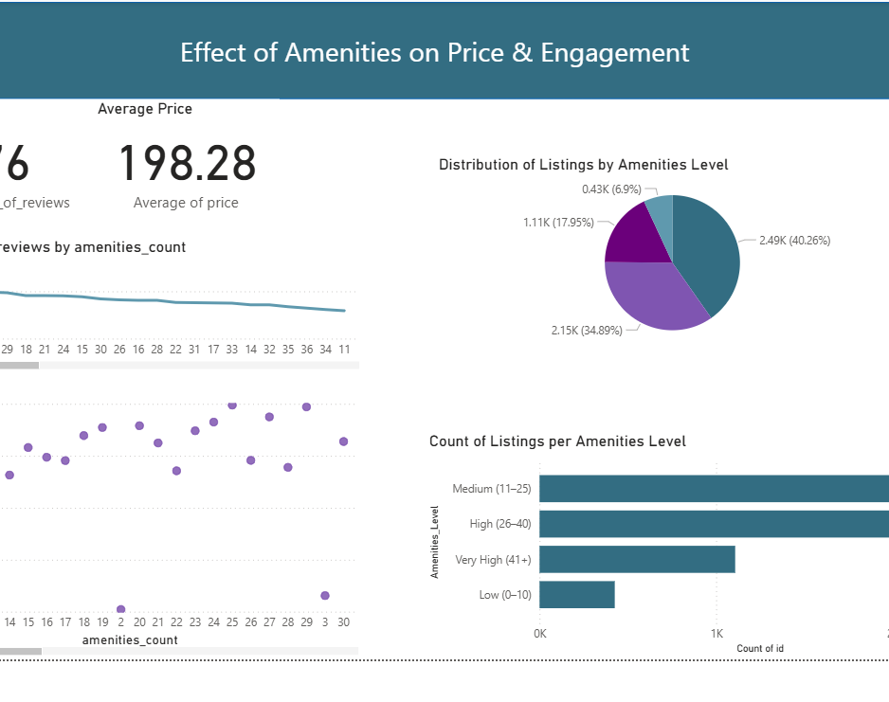
Dashboard Page 2 – Amenities Impact
Insights: Listings with more than 40 amenities tend to charge the highest prices Listings with 25–40 amenities get the most reviews → users value good balance between price and comfort Amenities clearly influence guest satisfaction and engagement.

Slide 11
Key Business Problem
Some areas have many listings but lower engagement or fewer amenities, which may lead to fewer bookings and lower satisfaction.

Slide 12
Business Recommendations
For Airbnb:
Upgrade amenities in popular but underpriced neighborhoods.
Encourage hosts to add more high-impact amenities (e.g., Wi-Fi, kitchen tools).
Promote listings with balanced price and features to improve reviews and bookings.
For Hosts:
Add Basic Amenities: Things like wireless chargers, kitchen tools, or good Wi-Fi are cost-effective (5–10 essential amenities).
In Upscale Neighborhoods (like De Pijp):
Avoid Luxurious Upgrades Unless Justified: High-end features like a jacuzzi should be used only if the listing matches the neighborhood’s luxury standards.
If your apartment is in a luxury area, guests may expect premium amenities but adding them to a basic listing could backfire.

Slide 13
Conclusion “From data to delight – it’s not just about numbers. It’s about experiences.”
This analysis revealed patterns in neighborhood performance, pricing strategy, and amenity impact.
Using data-driven decisions, Airbnb can improve both guest experience and host revenue.

Slide 14

“Happy Customer, Happy Company” Thank You

